Slide 1


The Package Handling System for the Mail Services Department at Stockton University
Eric Einhaus, Justin Winter, Austin Russo, Raymond Madden
Group #1

Slide 2
What does the Mail Services Department Do?
Main Goal: Transport packages and postal mail from sender to receiver (and vice-versa)
Convenient for Students: Students don’t to have to leave campus and go to a post office to collect and send out packages
Mail Services Department consists of 5 full-time employees and 20 part-time students
Process: Mail transport pick up packages via a postal truck and are placed into either a PO Box or through the customer service window if it is a package, the student is then notified by email. This is a continuous cycle each day until it closes at night

Slide 3
Organization History
Stockton University was established in 1969
First Year Students enrolled in 1971
Main Goal of Stockton: Educational program that provides students with a liberal arts background and to provide its students with a well-rounded education
Stockton Locations: Galloway, Atlantic City, Manahawkin, Hammonton, and Woodbine, New Jersey
Stockton Main Campus: 101 Vera King Farris Drive in Galloway, NJ

Slide 4
Stockton’s Subsystems
Registration: Keeps tracks of new students applying to Stockton
Residential Life: Provides students with housing on campus as well as maintenance for the students
Academic Affairs: Checks to see if the student is in good standing, so the student can continue to be enrolled and be provided with beneficial services
Student Records: Keeps records on all the information of any given student, to see if they are graduation eligible and have the required GPA
Admissions: Admits new students and transfer students to Stockton
Mail Services Department: Responsible for receiving packages of students, organizing them, and preparing them for student pick-up. Also responsible for letter mail services.

Slide 5
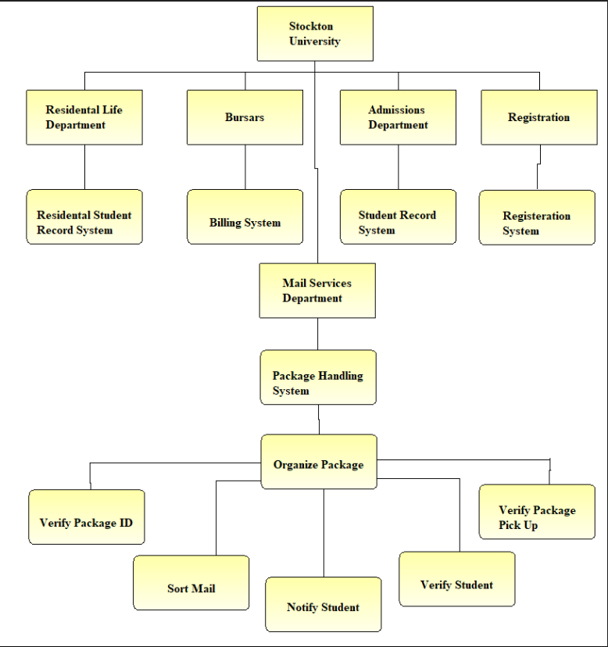
Functional Decomposition Diagram
Stockton University consists of 5 departments: Residential Life, Bursars, Admissions, Registration, and Mail Services
Mail Services is broken down into the Package Handling System
Package Handling System has one process called Organize Package
Organize Package has several subprocesses such as: Verify Package ID, Sort Mail, Notify Student, Verify Student, and Verify Package Pick Up

Slide 6
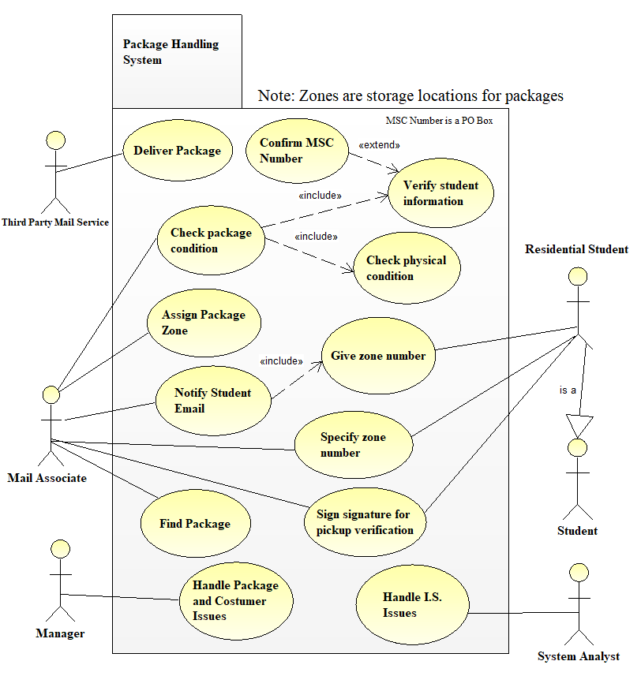
Use Case Diagram of
Package Handling System
Three Actors: Third Party Mail Service, Mail Associate, and Residential Student which is considered a Student
Third Party Mail Service delivers Package
MSC Number which extends the verification of the students information
Mail Associates checks package condition both to verify and check for physical damage
Notify Student’s email of package delivery and Zone Number
Student arrives at the Mailroom and provides zone number and signature for the package
Mail Associate Final Task: Find the package in the specific zone
Cycle restarts

Slide 7
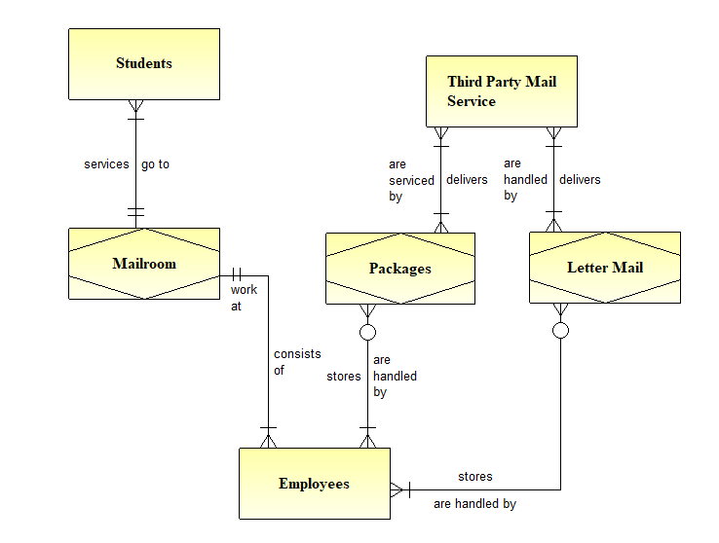
E-R Diagram

Slide 8
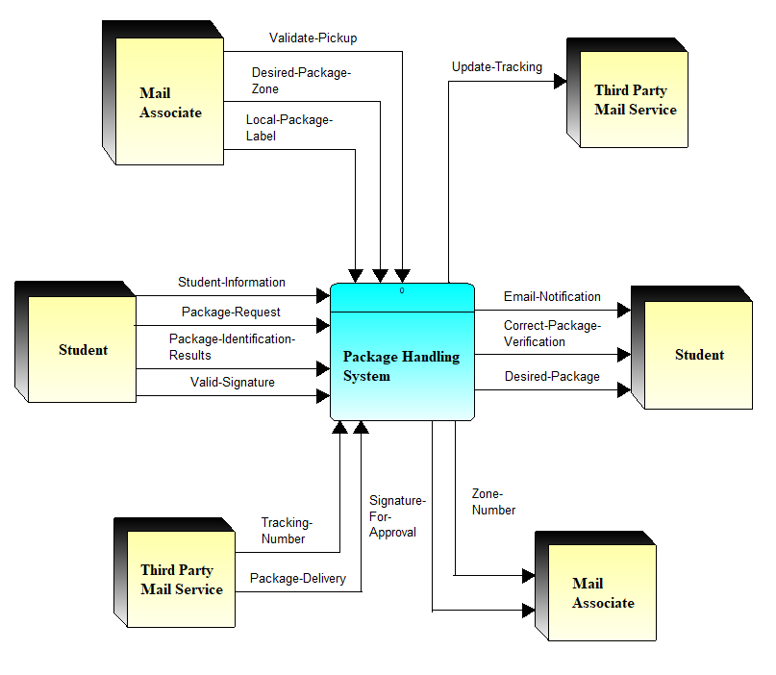
Context Level Data Flow Diagram of the Package Handling System
Three External Entities: Students, Mail Associates, and Third Party Mail Service such as DHL, UPS, and Fed-Ex that make up the Package Handling System
Notes:
Discuss Diagram

Slide 9
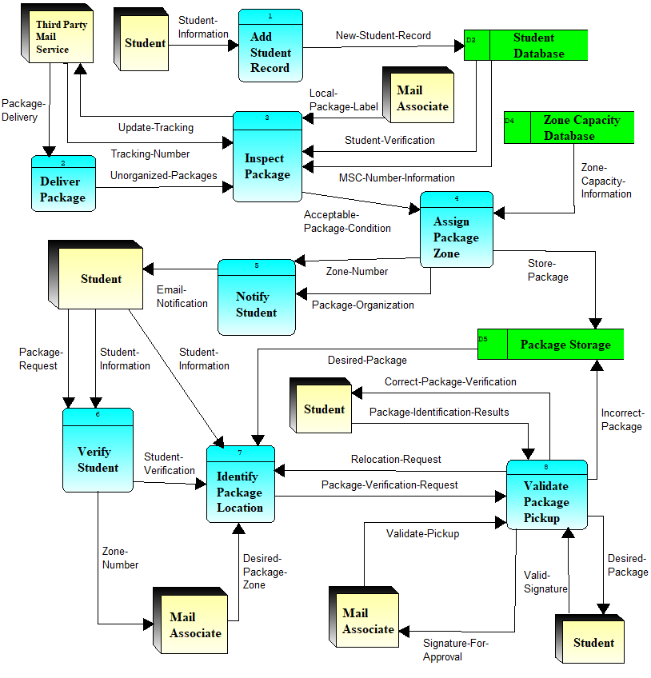
Diagram 0

Slide 10
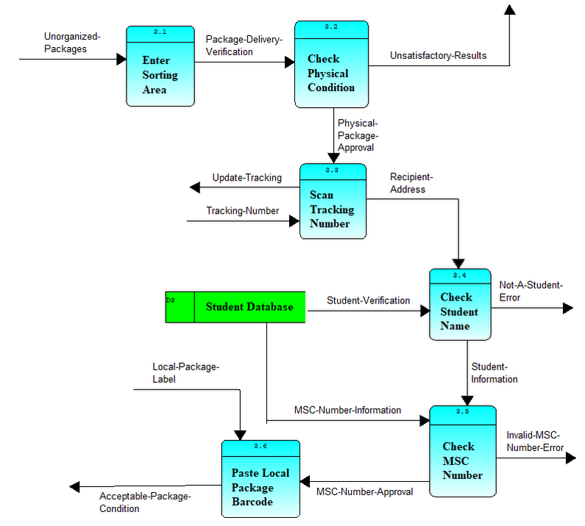
Child Diagram
(Process 3)

Slide 11
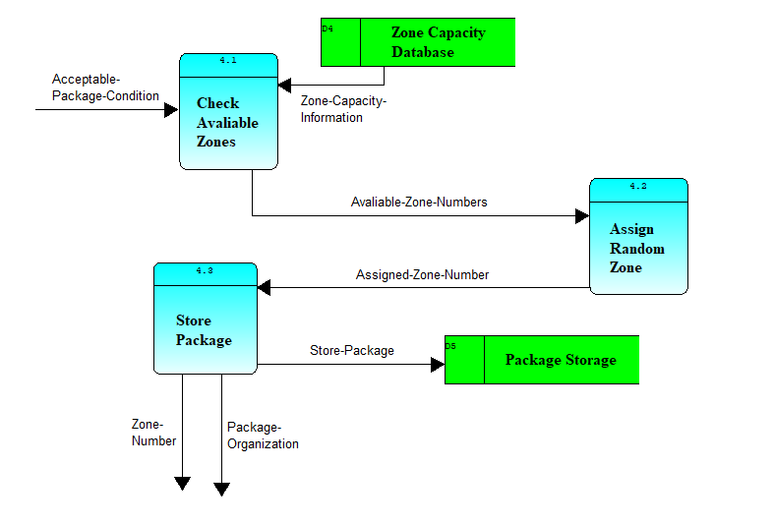
Child Diagram
(Process 4)

Slide 12
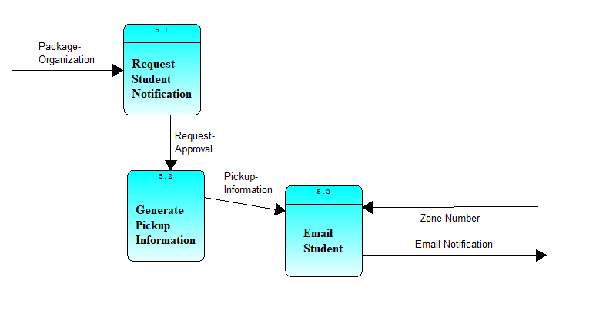
Child Diagram
(Process 5)

Slide 13
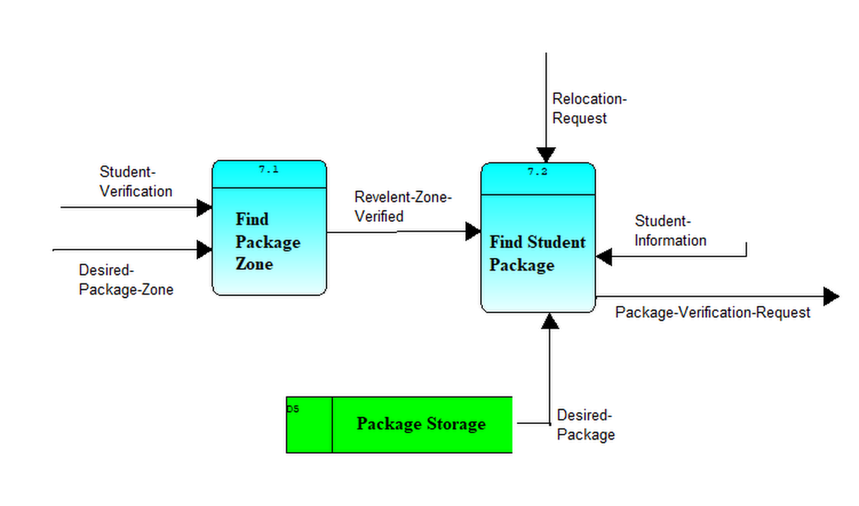
Child Diagram
(Process 7)

Slide 14
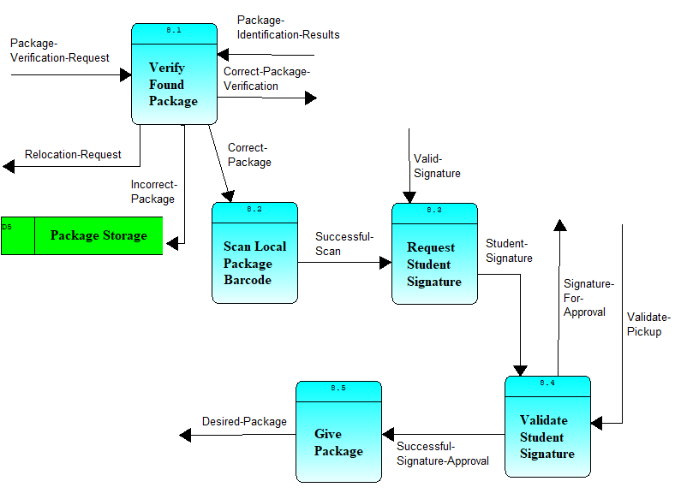
Child Diagram
(Process 8)

Slide 15
Process Specification Forms
The following are the process specification forms, with their corresponding decision trees, decision tables, or Structure English process logic.

Slide 16
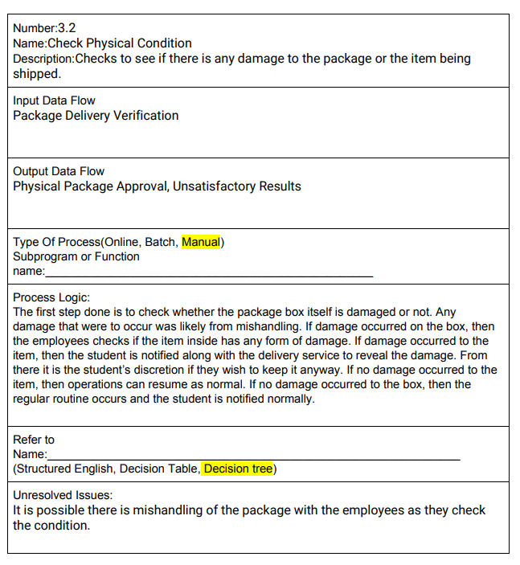

Slide 17
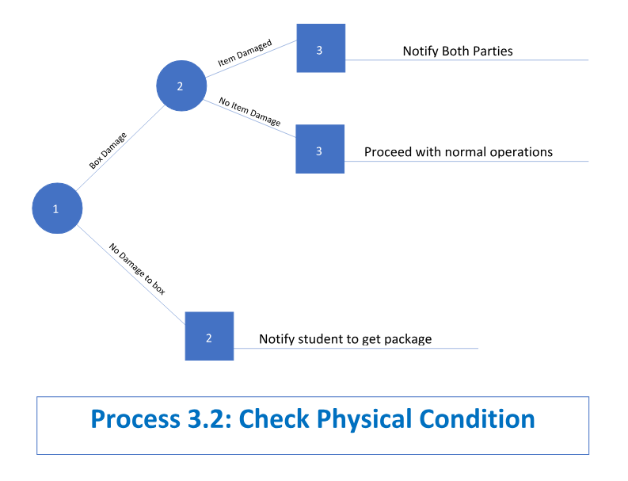

Slide 18
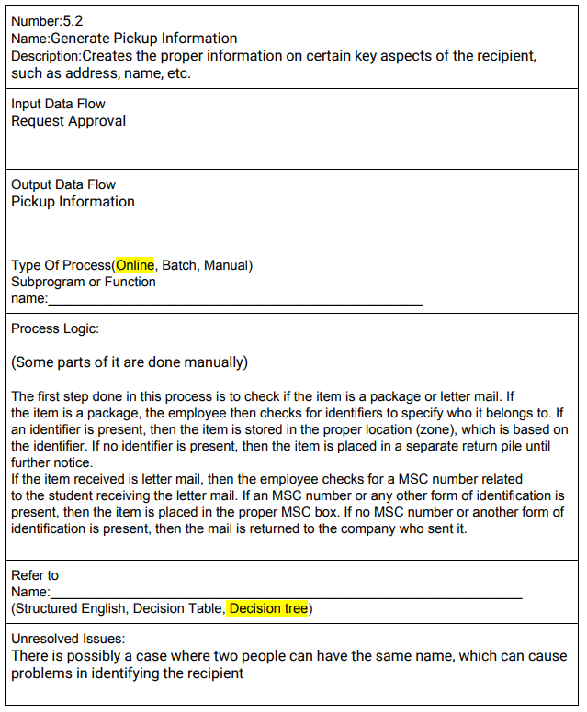

Slide 19
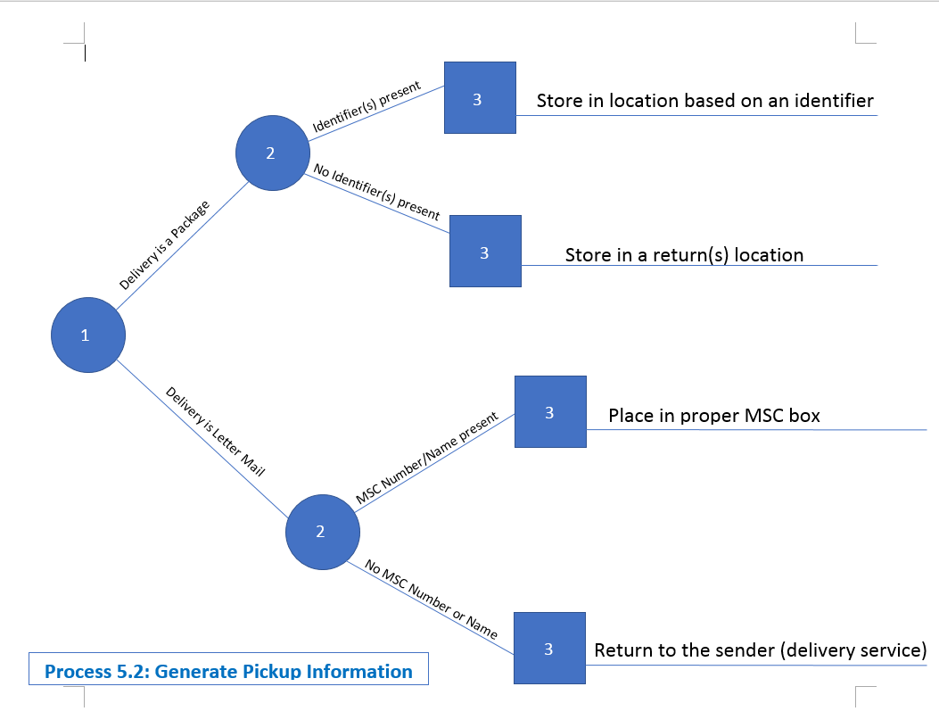
Add Decision Tree Example

Slide 20
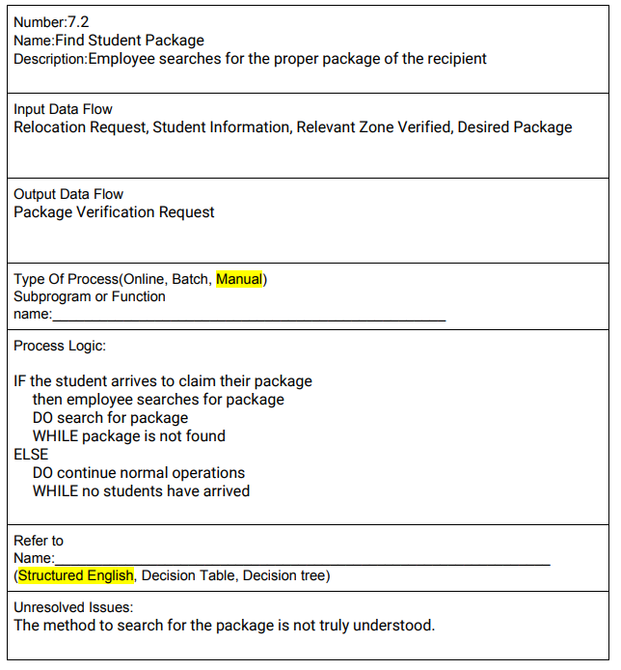

Slide 21
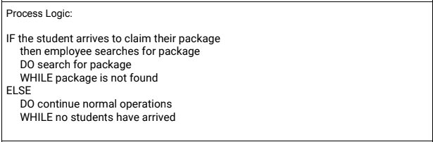
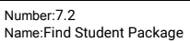
Structure English Example

Slide 22
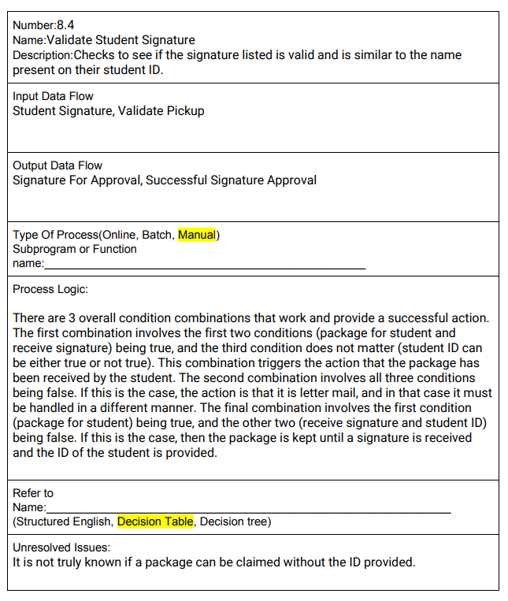

Slide 23
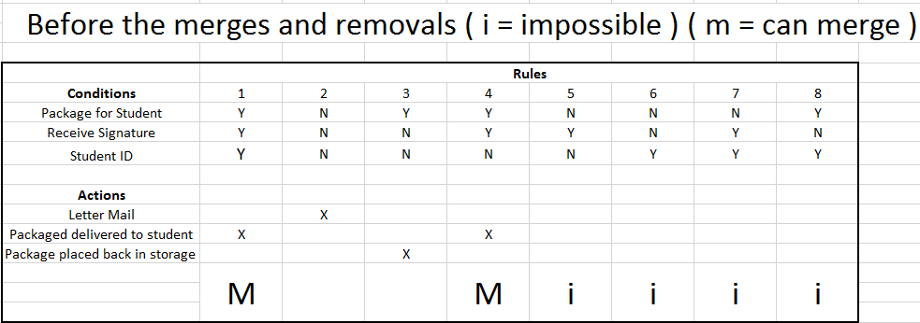
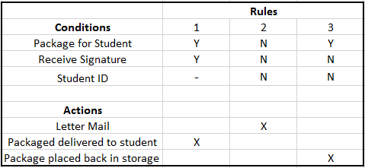
Add Decision Table Example

Slide 24
Project Repository
The following slides are the more prominent elements of the project repository. The screenshots are from Visible Analyst.
3 External Entities
8 Total Processes on Diagram 0 (3 will be shown on further slides)
6 Child processes (3.2, 3.4, 4.1, 7.2, 8.1, 8.4)
9 input data flows from external entities (2 will be shown on further slides)
6 output data flows to external entities (2 will be shown on further slides)
3 Data Stores

Slide 25
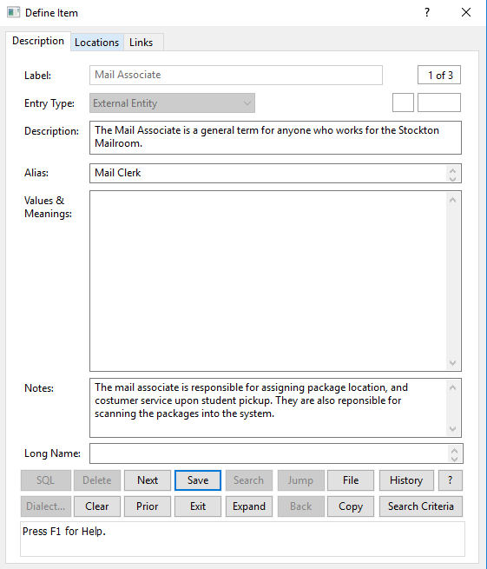
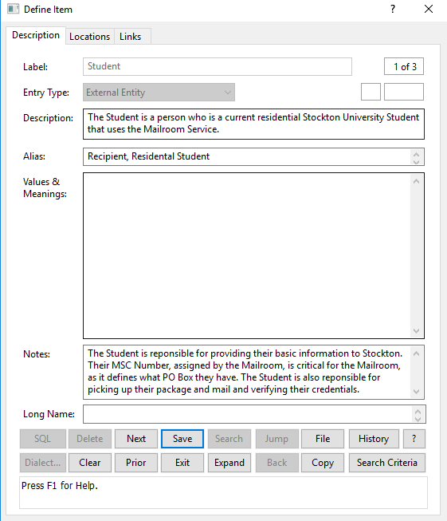
External Entities

Slide 26
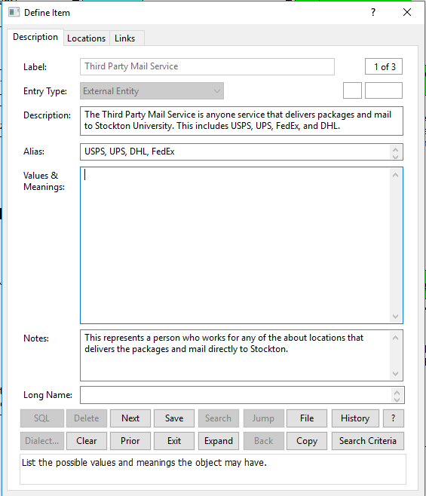

Slide 27
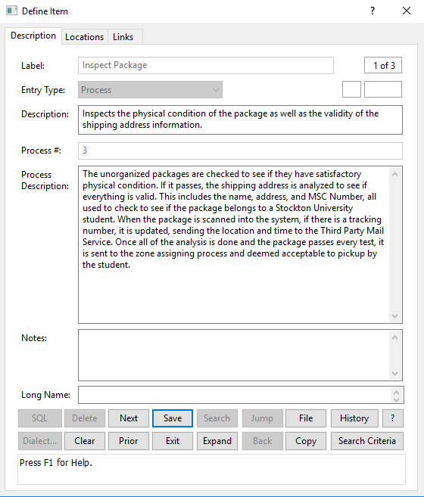
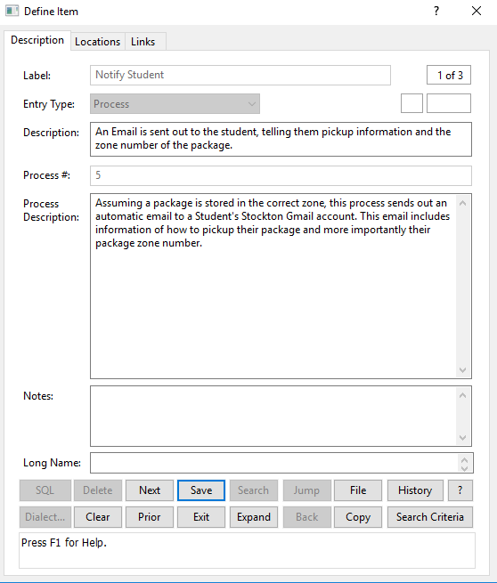
Diagram 0 Processes

Slide 28
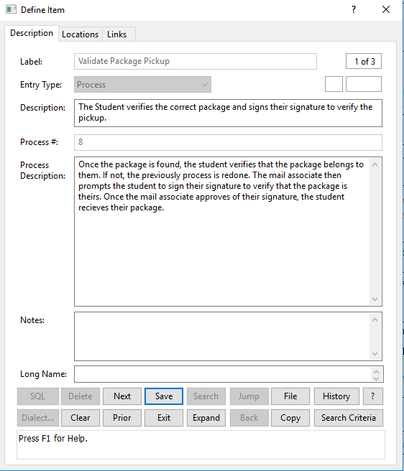

Slide 29
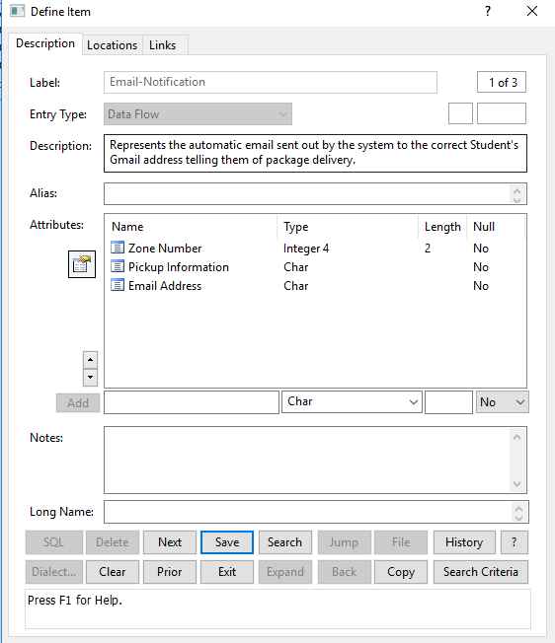
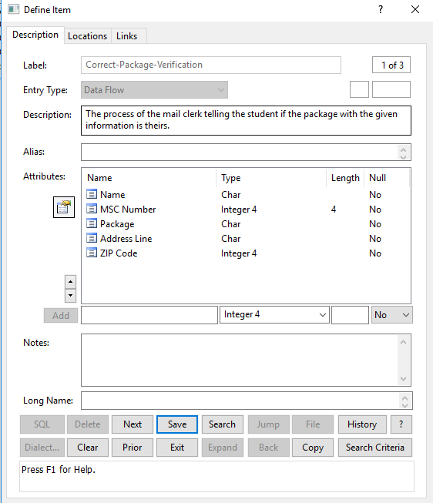
Output Data Flows

Slide 30
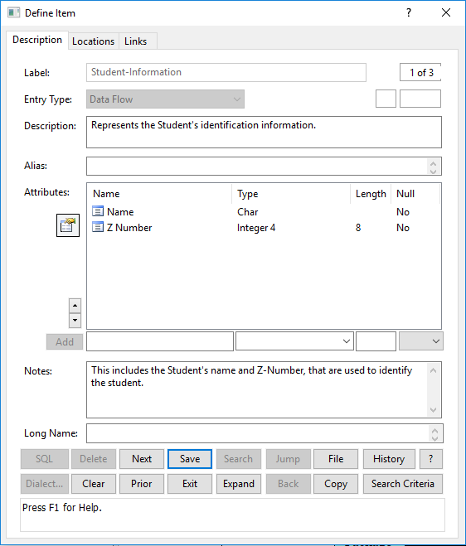
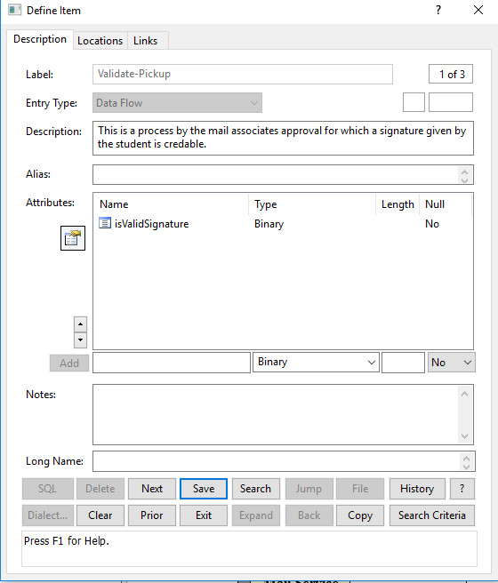
Input Data Flows

Slide 31
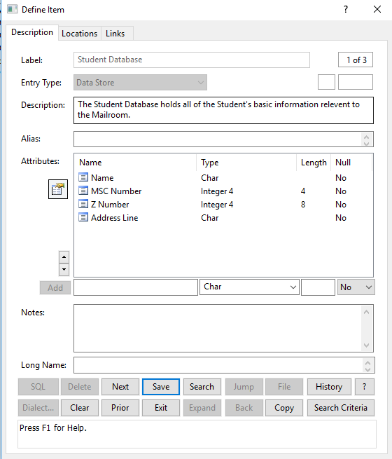
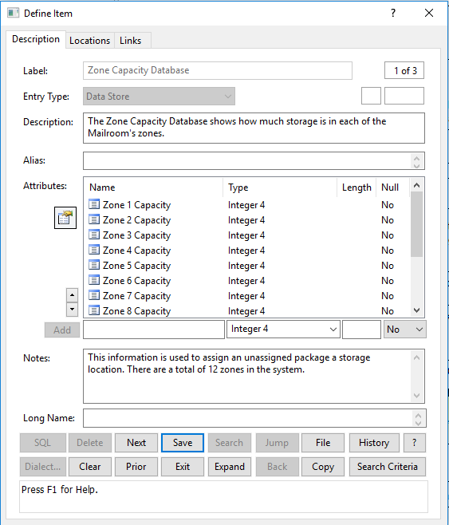
Data Stores

Slide 32
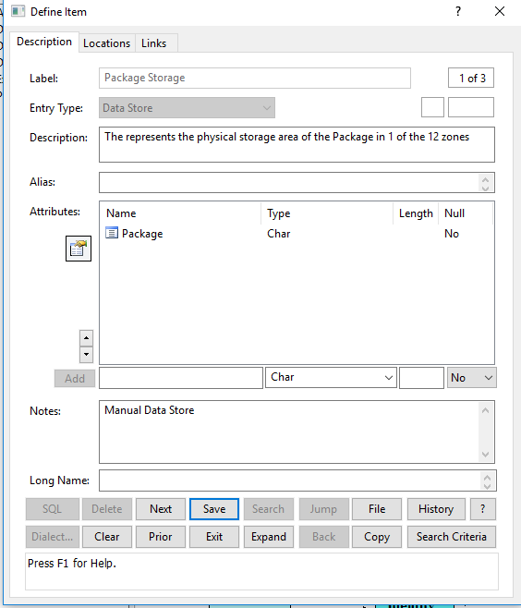

Slide 33
Problems with the Package Handling System
Small packages and letter mail give no notification to the recipient (student). This would cause an inevitable buildup if the student does not collect, as they would be unaware if their mailbox has mail inside for retrieval.
There is no notification via text message. Texts are more likely to be noticed as people check their phones more than they do email.
Students often complain about the long lines. This is mainly due to one person running the mail pickup counter, and the time it takes to receive a package is rather long.
A package could possibly lack an MSC number. This would cause problems if two people share the same name. This therefore causes identity problems for the mail clerk.

Slide 34
Objectives of the New Information System for Mail Services
Increased Customer satisfaction through better and cleaner package pickup
Better notifications through text messages and email, which include improvements to the current system and an additional notification system for letter mail and small packages
Reduced wait time to remove the long and tedious lines, which can be accomplished through either a queue system or more workers

Slide 35
User Interface
The following the proposed screens for the new information system of the mailroom.

Slide 36
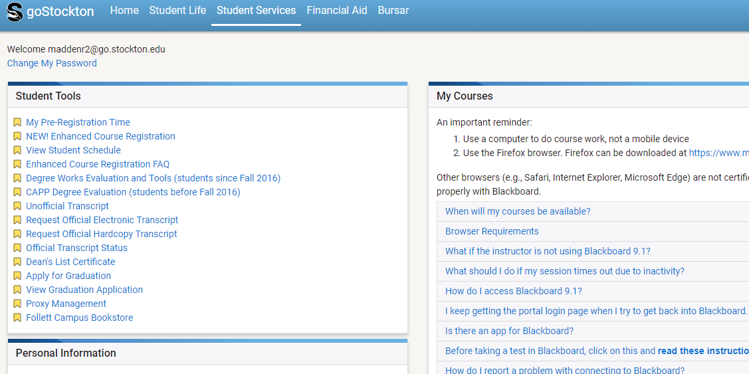

Slide 37
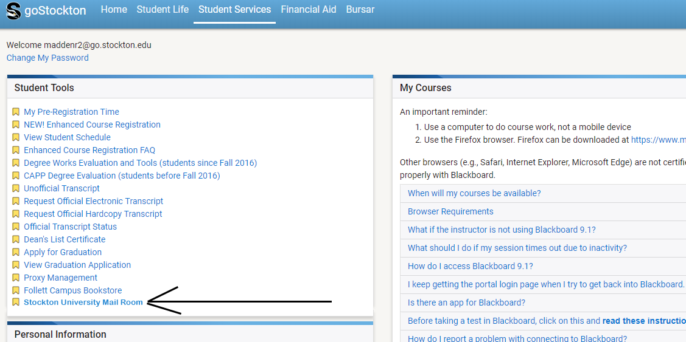

Slide 38
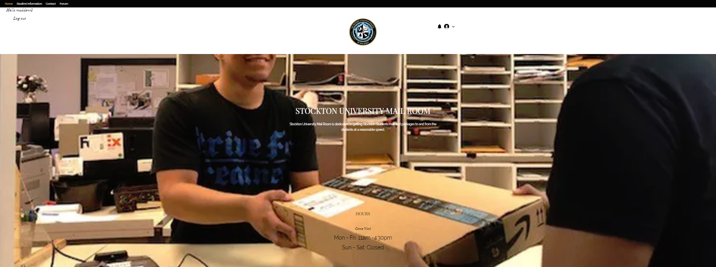

Slide 39
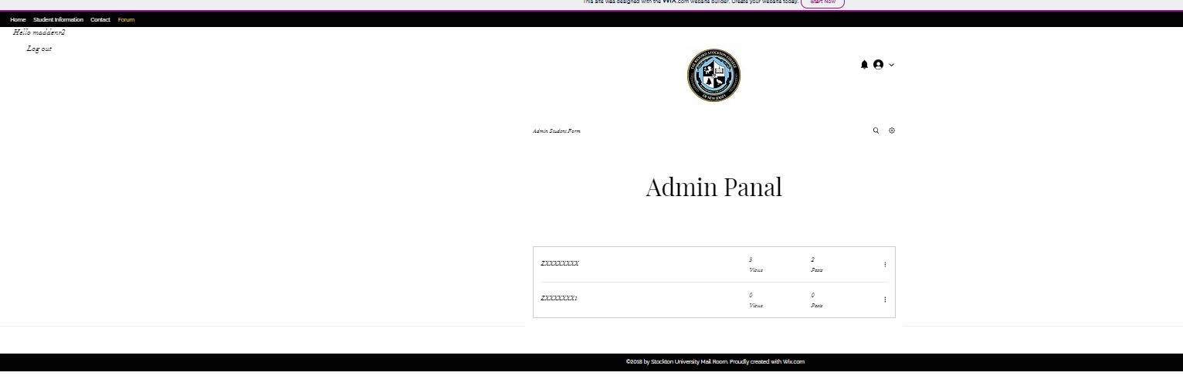

Slide 40
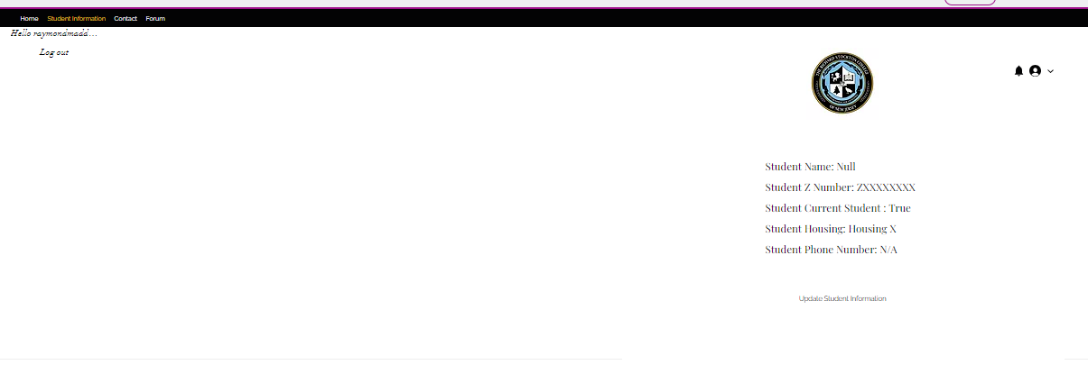

Slide 41
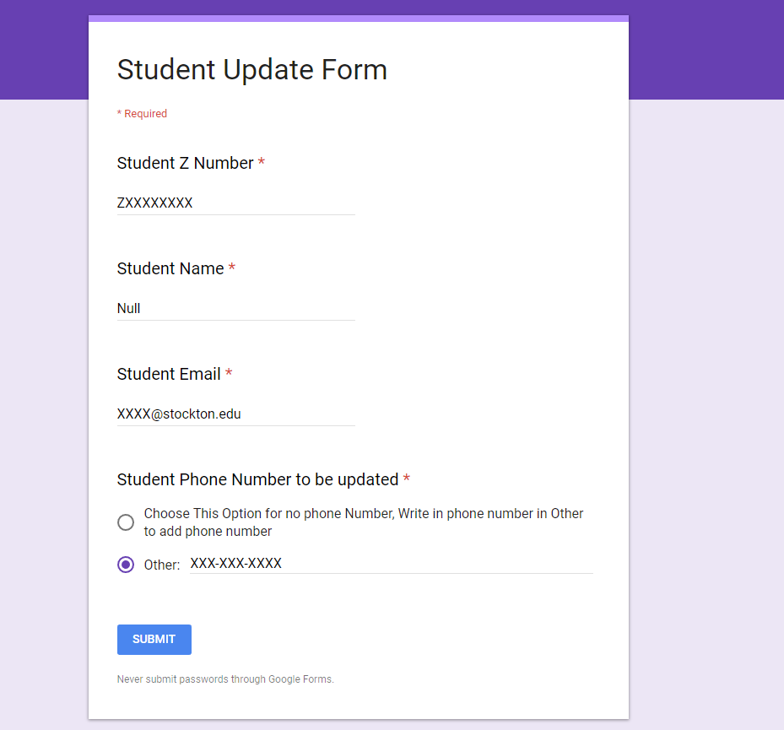

Slide 42
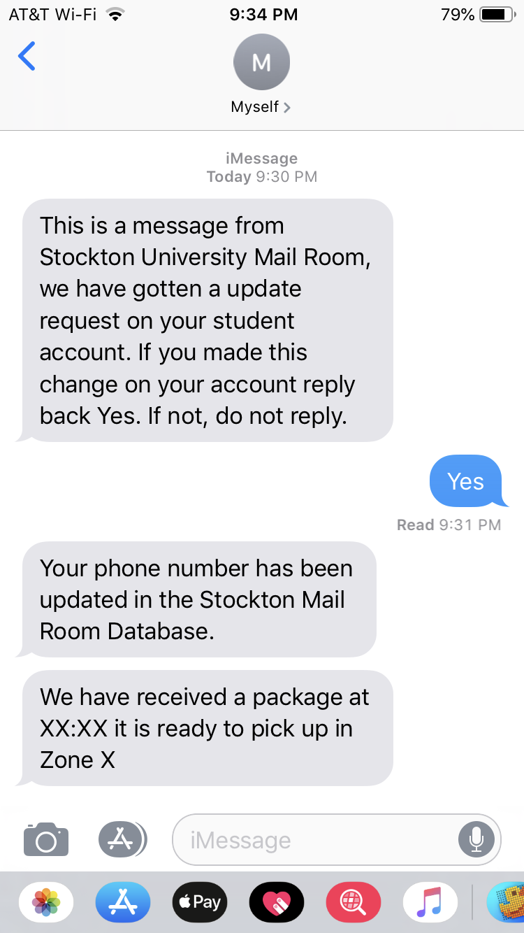
Text Notification Example

Slide 43
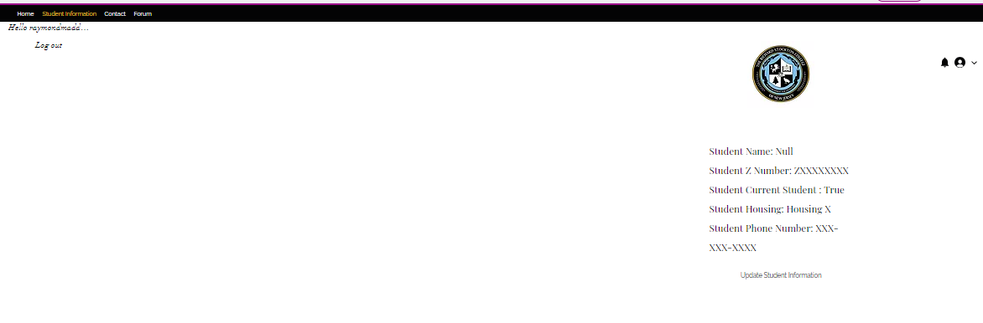

Slide 44
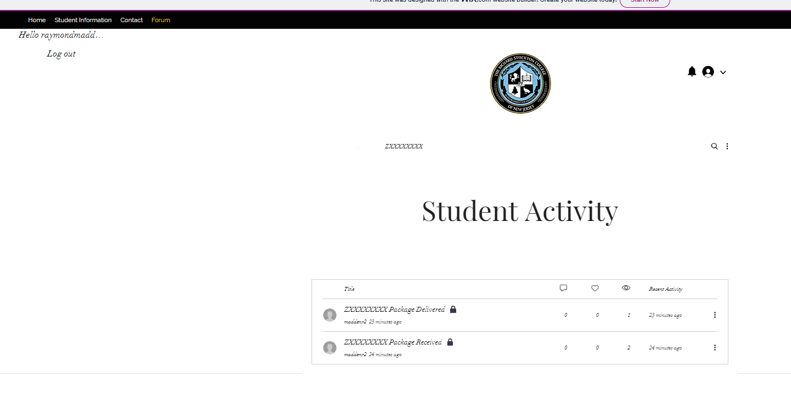

Slide 45
